Slide 1
Physical Activity Participation and Physiological Performance Revision!
Unit 3 Physical Education

Slide 2
Benefits of Physical Activity
List all the benefits of physical activity you can think of on the board.
Notes:
Then catagorize them into physical, health, social, emotional

Slide 3
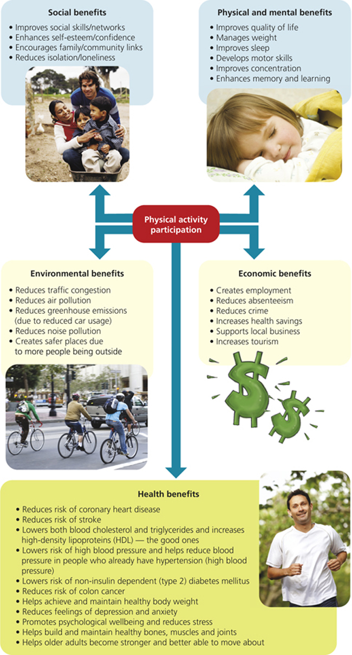

Slide 4
National Physical Activity Guideline for Adults
1.
2.
Notes:
Give handout and page 8

Slide 5
National Physical Activity Guideline for Adults
3.
4.

Slide 6
National Physical Activity Guidelines for overweight and obese
Notes:
On handout

Slide 7
National Physical Activity Guidelines for older adults
1.
2.
3.
4.
5.

Slide 8
National Physical Activity Guidelines for 12-18 year olds

Slide 9
National Physical Activity Guidelines for 5-12 year olds

Slide 10
National Physical Activity Guidelines for early childhood
0-1 years –
1-3 years (Toddlers) –
2-5 years -

Slide 11
Assessing physical activity
How do we assess physical activity? List as many methods as you can

Slide 12
Objective vs Subjective
Subjective measures –
Objective measures -
Notes:
Subjective methods depend on a persons own perceptions. Predominantly used for measurement in populations. (page 14)
Objective methods rely on solid data or observations. OBJECTS and OBSERVATION. Predominantly used for assessing individuals. (page 16)

Slide 13
Subjective methods
List all the subjective methods here
Notes:
Page 14

Slide 14
Diaries
Definition –
Advantages –
Disadvantages –
What element/s of PA it measures -

Slide 15
Logs
Definition and examples –
Advantages –
Disadvantages –
What element/s of PA it measures -

Slide 16
Recall Surveys
Definition and examples –
Advantages –
Disadvantages –
What element/s of PA it measures -

Slide 17
Self-Administered Physical Activity Checklist
Complete the SAPAC provided to you

Slide 18
What about the children?
How do things change for children under 10?
Notes:
Children under 10 must be completed by a proxy (parent/guardian/teacher).

Slide 19
Objective Measures
List all the objective measures

Slide 20
Pedometers
Definition and examples –
Advantages –
Disadvantages –
What element/s of PA it measures -

Slide 21
Heart Rate Monitors
Definition and examples –
Advantages –
Disadvantages –
What element/s of PA it measures -

Slide 22
Julz Heart Rate during fitness circuit!

Slide 23
Accelerometer
Definition and examples – Look up actiGraph
Advantages –
Disadvantages –
What element/s of PA it measures -

Slide 24
Accelerometer Data

Slide 25
Electronic Motion Sensors
Definition and examples –
Advantages –
Disadvantages –
What element/s of PA it measures -

Slide 26
Observation
Definition and examples –
Advantages –
Disadvantages –
What element/s of PA it measures -

Slide 27

Assessing sedentary behaviour
How do we do it?
Notes:
Diaries/logs, Observation, Recall surveys

Slide 28
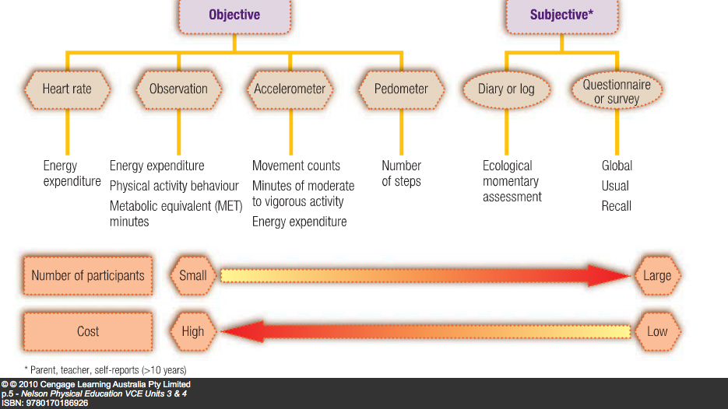

Slide 29
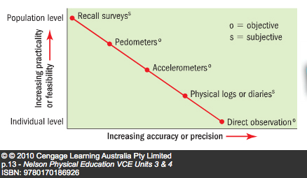

Slide 30
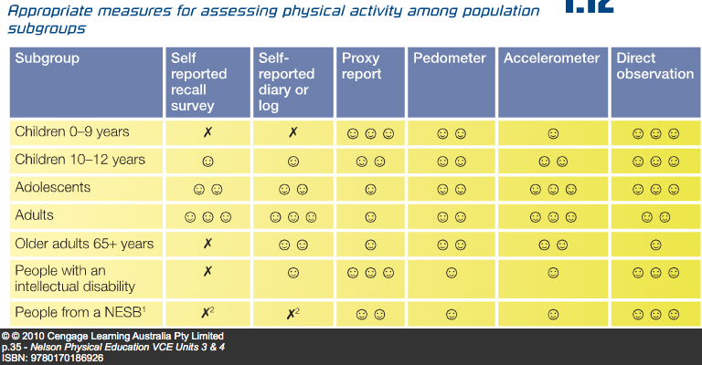

Slide 31
Elements determining physical activity levels
F =
I =
T =
D =

Slide 32

Frequency
Definition
How can we measure it?
Notes:
How often?
Diaries/logs

Slide 33
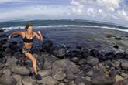
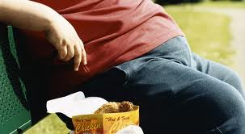
Intensity
Definition -
How can intensity be assessed?
Notes:
How hard or how much effort?
Talk test
Percieved exertion
HR 50-70 moderate 70-85 vig
METS

Slide 34
Measuring intensity : Pykeys percieved exertion using Borg Scale during fitness circuit

Slide 35
METs
Definition -
Low intensity –
Medium intensity –
Vigorous intensity -
What MET value will the following activities. Guess then use page

Slide 36
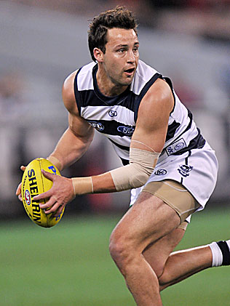
Met value =
Notes:
9

Slide 37
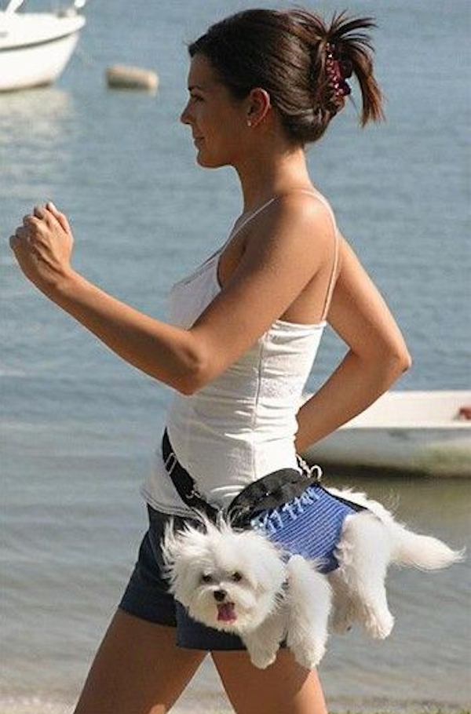
MET value =
Notes:
3

Slide 38
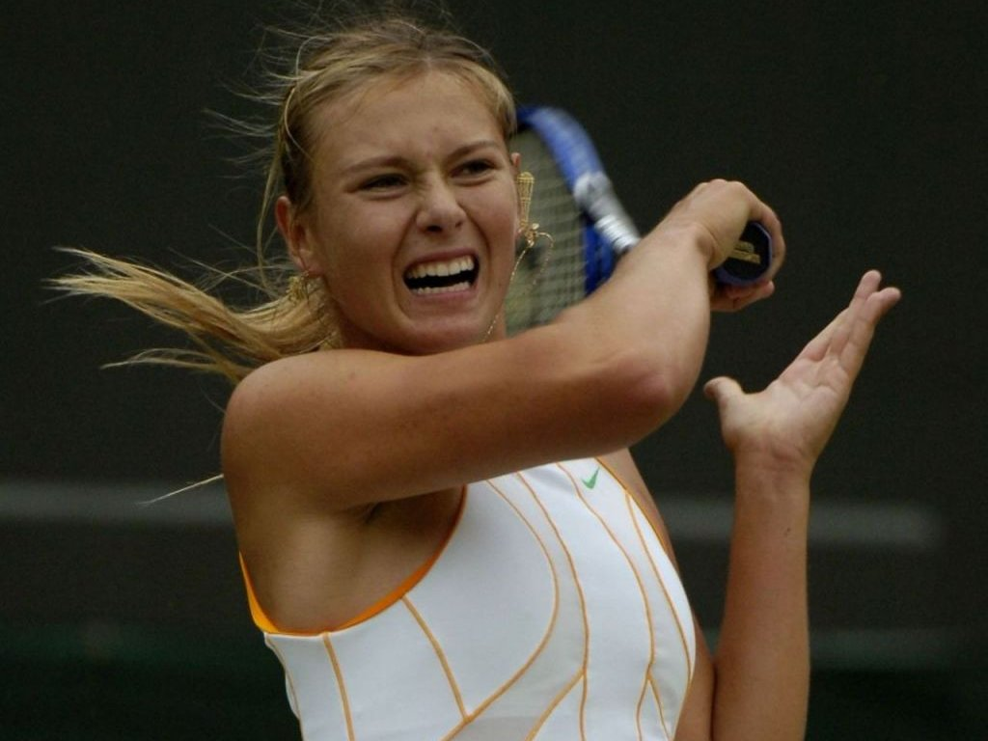
MET value =
Notes:
7-8

Slide 39
Add in more examples of your own

Slide 40
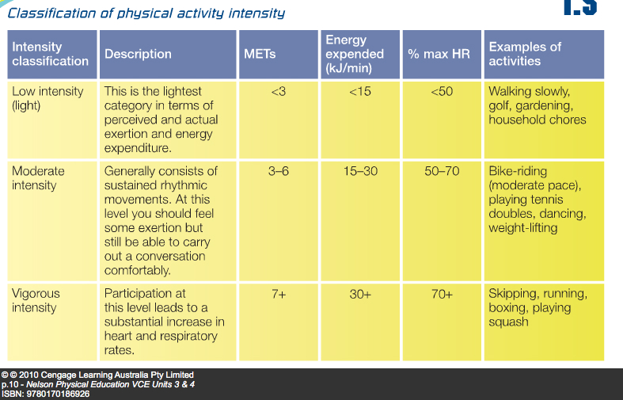

Slide 41
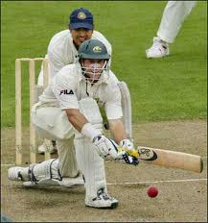
Type
Definition

Slide 42
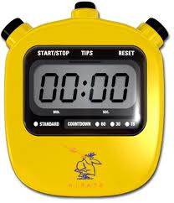
Duration
Definition

Slide 43
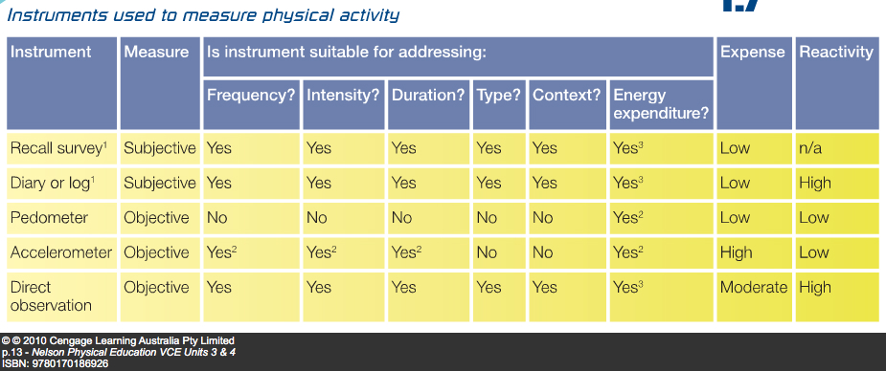

Slide 44
NPAG and Elements

Slide 45
Adults
F -
I -
T -
D -

Slide 46
Older adults
F -
I -
T -
D -

Slide 47
12-18 Year olds
F -
I -
T -
D -

Slide 48
5-12 Year olds
F -
I -
T -
D -

Slide 49
Social-Ecological model
Levels
1.
2.
3.
4

Slide 50
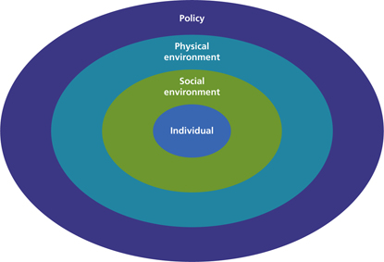

Slide 51
Individual Level
Definition and examples
Notes:
The individual domain is at the centre of the model. At this level self-efficacy, values, beliefs, attitudes, knowledge and preferences are all important factors. But this model also recognises the external factors that are important in influencing behaviour, such as socioeconomic status, job status and educational level

Slide 52
Social Environment Level
Definition and examples
Notes:
The social environment domain is the first of the external forces acting on the individual. The influence of people close to us affects our behaviour. At this level, we consider the social interaction of family and friends. These primary interactions represent the associations that provide social identity and role definition.

Slide 53
Physical Environment Level
Definition.
Natural examples -
Man-made examples -
Notes:
The physical environment domain includes the influences of the natural and built environment on the individual's ability to be active. Human health and wellbeing is reliant on a healthy physical environment. The physical environment includes both the built environment and the natural environment — the air we breathe and the water we drink. The built environment includes roads, parks, public transport, housing, shops, commercial business and factories. These may discourage or encourage activity depending on their design and location. For example, busy streets tend to discourage walking, whereas the provision of a gym at work and suitable policies would encourage physical activity.

Slide 54
Policy Level
Definition and examples

Slide 55
Relationship between the levels.
Notes:
The multiple levels of influence interact with each other and no single factor will lead to a change in an individual’s behaviour. An initiative that targets all four levels of influence is more likely to change a person’s behaviour. The individual may have the required skills and fitness to ride to work, but without the support of his/her spouse/peers/work colleagues, access to a bike and other cycling accessories, and a flexible starting time for work they may not make a change to their behaviour.

Slide 56
NPAG’s
Definition and examples

Slide 57
FITD
Definition and examples

Slide 58
Objective and subjective measures
Definition and examples

Slide 59
Social ecological model
Definition and examples

