Slide 1
Energy for Physical Activity
Mr Saunders

Slide 2
Adenosine Triphosphate (ATP)
Adenosine Triphosphate (or ATP as its more commonly known) is the bodies “currency” of all body cells.
Just like money if you don’t have enough to spend then the body can’t get anywhere
It gives muscle cells the power to contract!
ATP consists of an Adenosine molecule and 3 Phosphates.

Slide 3


Slide 4
Creating energy!
So how does ATP create energy?
When the muscle cell wants needs energy it breaks down the bond of the last phosphate so that it is released.
This then creates ADP (Adenosine and 2 phosphates) and an inorganic phosphate.

Slide 5
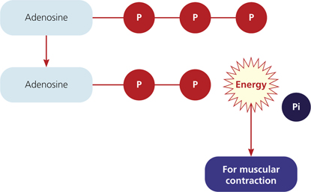

Slide 6


Slide 7
Where do we get the ATP from?
ATP is constantly replenished/resynthesized through several different energy fuels.
After energy is created ADP needs to replenish to ATP by gaining a Phosphate molecule back. This process is called Phosphorylation and is done with the help of our energy fuels.

Slide 8
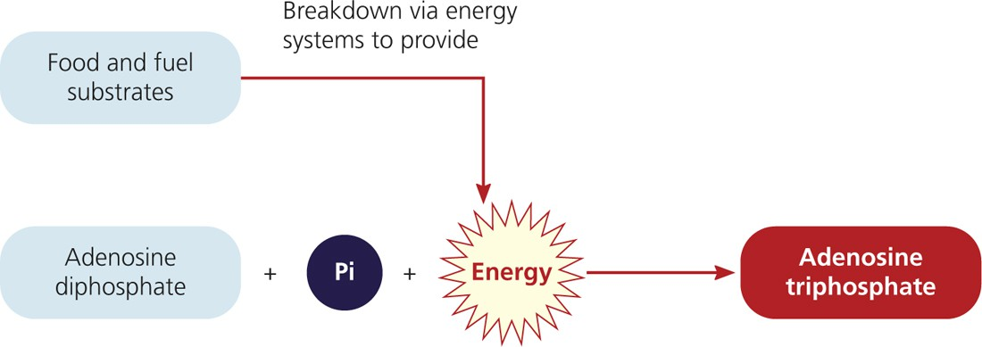

Slide 9
Replenishing ATP
ATP can be replenished through these energy fuels
Phospho-creatine
Carbohydrates
Proteins
Fats
These fuels can provide energy required for ATP replenishment as long as they are available.

Slide 10
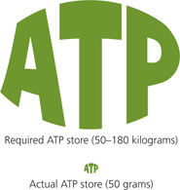

Slide 11
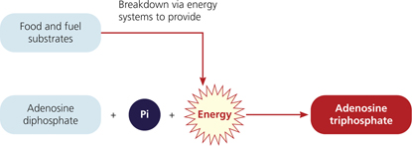

Slide 12
Do test your understanding on page 54

Slide 13
Aerobic vs Anaerobic
ATP can be replenished with or without oxygen.
Aerobic metabolism – is where the replenishment happens in the presence of oxygen
Anaerobic metabolism – is where the replenishment happens WITHOUT the presence of oxygen

Slide 14
Phosphocreatine (PC)
Chemical Fuel consisting of a Phosphate and Creatine molecule.
Phosphocreatine (PC) or creatine phosphate (CP) is stored within the muscle cells.
Energy system used is ATP-PC and therefore does NOT need oxygen.
Very short/fast chemical reaction
Very small energy per molecule = less than 1 mol
Maximal intensity

Slide 15


Slide 16
Carbohydrates for energy
Natural and essential part of diet.
Carbohydrates are the bodies preferred source of energy during exercise.
It comes from the foods we eat e.g pasta, cereals etc
Carbohydrates are present in the blood (transport form) as GLUCOSE.
Carbohydrates are stored in the muscle and liver (storage form) as GLYCOGEN.
Excess carbohydrates are turned in adipose tissue (fats) and stored around the body.

Slide 17
Carbohydrates
Carbohydrate foods can be measured on a glycaemic index (GI) on a scale of 0-100.
High GI foods are rapidly digested and absorbed. E.g white bread, sports drink
Low GI foods are digested more slowly and provide longer lasting energy. E.g oats, mixed grain bread

Slide 18
Glycaemic Index
High Gi – 70+
Moderate GI 50-70
Low GI – 50 or below
Sports Drink – 78
Coco-Pops – 77
Muffins – 62
Boiled Potato - 56
Pasta – 50
Kidney Beans – 36
Raspberries - 32
All Bran - 30

Slide 19
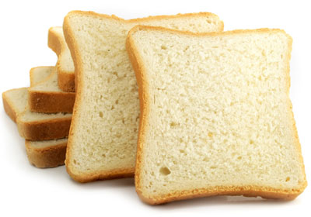
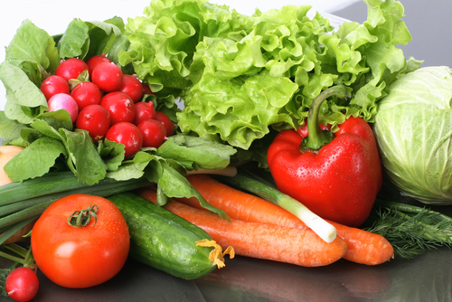
High GI Low GI

Slide 20
Carbs continued
Carbohydrates can be used by the aerobic and anaerobic glycolysis energy systems.
Carbohydrates can be used to replenish ATP WITH or WITHOUT oxygen.
High energy per molecule 2-38 energy per mol.
CHO has a medium length chemical reaction.
Can be used in submaximal or maximal intensity

Slide 21
Carbohydrate Loading
In events lasting longer than 90 minutes.
Involves 2-7 days of tapering of training and increased consumption of Carbohydrates to fuel the event.
Increases the amount of Carbohydrates stored in the body (as muscle glycogen).
Can cause bloating and heaviness due to increased water stores.
Will increase weight of the athlete.

Slide 22
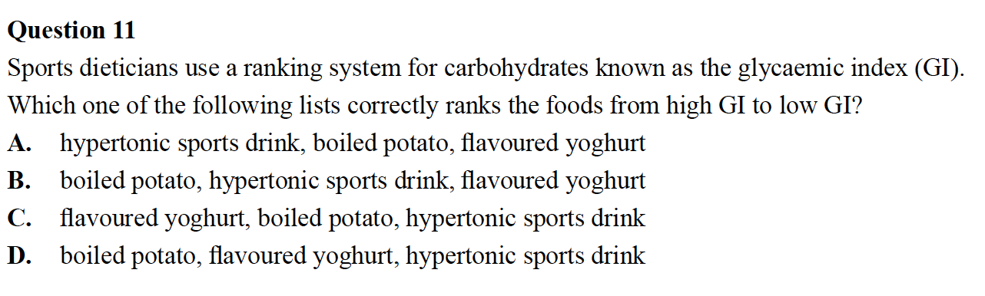
Exam Question

Slide 23
Exam Question

Slide 24
Glycaemic Index Challenge
List the foods up the front from Highest GI to Lowest Gi
Coffee Scroll
Tuna and Beans
Donuts
Jelly Beans
Strawberries

Slide 25
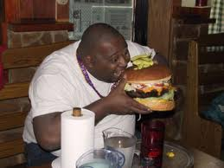
Fats (Lipids) as an energy source
Fats are stored as free fatty acids in the blood (transport form).
Fats are stored in the muscle as triglycerides (storage form).
Excess fats are stored around the body as adipose tissue.
Can only be used by aerobic energy system
Fats are the most concentrated of all the energy sources. Providing the most energy per gram.
100-300 mole per gram
Need a LOT of OXYGEN
Medium length chemical reaction.
Submaximal intensity only!

Slide 26
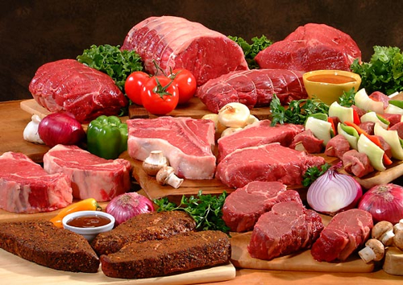
Proteins
Protein allows for muscle growth and repair, fights disease, helps chemical reactions and transports materials.
Proteins are stored as amino acids in the blood and muscles. (Transport and storage form)
Amino acids are the building blocks of the body
Excess stored as adipose tissue around body
We can get proteins from a range of foods including meat, eggs and dairy products.
Used by aerobic energy systems only in emergencies, when carbohydrates and fat sources have been depleted, such as the end of an submaximal intensity endurance event e.g ultra marathon

Slide 27
How much should we eat?
Carbohydrates 55-65% (up to 60-80 for endurance athlete)
Fats 20-25% (upto 25-30% for endurance athlete)
Proteins 15% (more for power athletes)

Slide 28
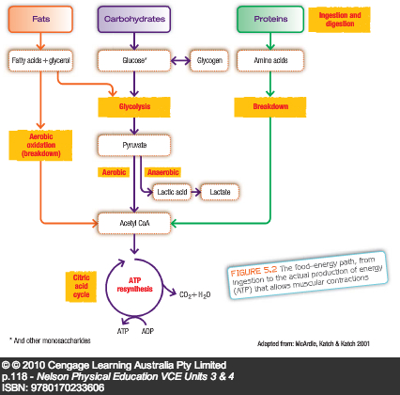

Slide 29
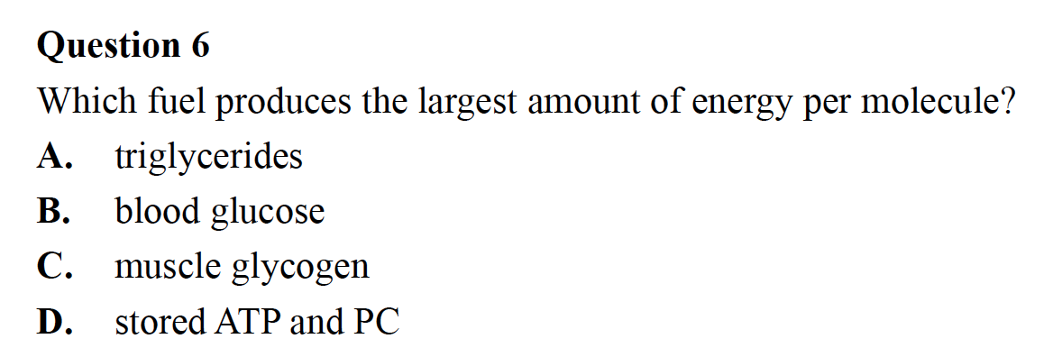

Slide 30
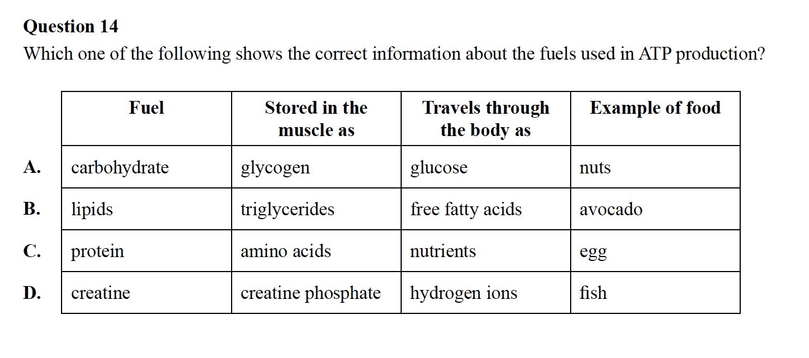

Slide 33
Fuel sources at rest
At rest fats contribute the majority of the fuel needed (about 2/3). This is because there is an abundance of oxygen and plenty of time to break it down.
Uses aerobic energy system.

Slide 34
Fuels sources at rest
Byproducts of aerobic energy system are
  H20 (Water) – Sweat and breath
  CO2 (Carbon Dioxide breathed out)
  ATP (Energy)
No fatiguing by products!

Slide 35
Fuel sources at submax exercise
Carbohydrates become the major source of fuel at submax exercise as energy is required more quickly.
CHO are broken down more easily so therefore can provide us with quicker energy source.
Proteins can be used generally after 4 hours when other sources are depleted.

Slide 36
Fuel sources at submax exercise
Uses anaerobic glycolysis energy system
Byproducts are fatiguing

Slide 37
Fuel sources at maximal exercise
Carbohydrates provide all the fuel source during maximal exercise.
If not enough oxygen is present lactic acid will be a byproduct.

Slide 38
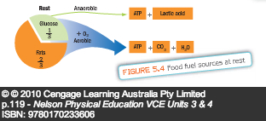
Rest

Slide 39
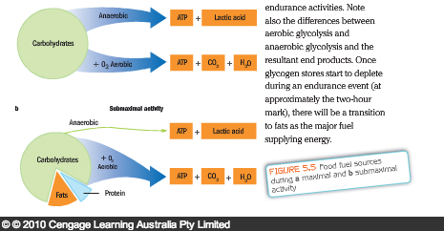
Exercise

Slide 40
Food for thought
Answer these questions.
How would a diet for a weight lifter and a marathon runner? Give reasons why using specific information about the fuel sources.
If fats provide the most amount of energy per gram why isn’t it the bodies preferred source of energy during exercise?
When do we use proteins for energy?

